Slide 1


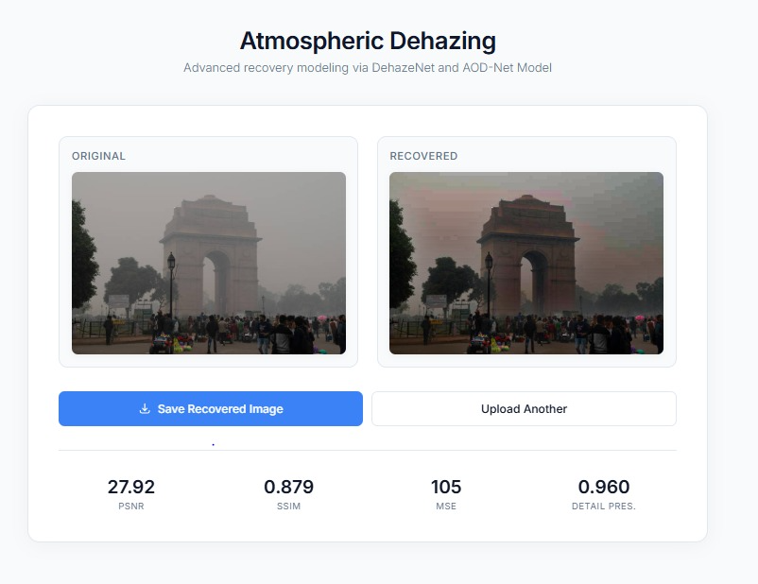
Dehaze it!!
Team: Binary Bandits
We restore clarity to outdoor and aerial photos by removing atmospheric haze while preserving natural color and detail — fast, robust dehazing for photography, remote sensing, and computer vision workflows.
By :- Mohd. Dayyan(123ad0054), Aditya Seth(523cs0018) and Syed Aftab(123cs0068)

Slide 2


PROJECT OBJECTIVES
PROJECT OBJECTIVES
Primary Goals:
Remove atmospheric haze, fog, and smog from digital images
Preserve image quality and fine details during dehazing
Provide real-time processing through web interface
Implement professional-grade algorithms for accurate results
There was an error generating this image
Key Features:
✅ DehazeNet Deep Learning Model Implementation
✅ AOD-Net (All-in-One Dehazing Network) Integration
✅ Dark Channel Prior algorithm for traditional processing
✅ Guided filtering for transmission map refinement
✅ Atmospheric light estimation
✅ Scene radiance recovery
✅ Professional metrics calculation (PSNR, SSIM, MSE, Detail Preservation)

Slide 3


SYSTEM ARCHITECTURE
SYSTEM ARCHITECTURE
Backend Components:
Frontend Components:
Python HTTP Server (http.server, socketserver)
OpenCV for image processing and filtering
PIL/Pillow for image manipulation
NumPy for numerical computations
SciPy for advanced image analysis
Deep Learning Framework Integration (PyTorch/TensorFlow)
Pre-trained DehazeNet Model Architecture
AOD-Net Model for End-to-End Dehazing
Modern HTML5/CSS3 Interface
Responsive design with CSS Grid/Flexbox
JavaScript for client-side interactions
Drag & drop file upload functionality
Real-time processing feedback
Algorithm Pipeline:
01
DehazeNet Deep Learning Processing (Primary)
02
AOD-Net End-to-End Dehazing (Alternative)
03
Dark Channel Prior Computation (Traditional)
04
Atmospheric Light Estimation
05
Transmission Map Calculation
06
Guided Filter Refinement
07
Scene Radiance Recovery
08
Quality Enhancement & Post-processing
Postprocessing
Quality metrics and save
Processing Layer
Preproc → Algorithms → Deep GPU
Load Balancer
Distribute requests
API Gateway
Route and auth
Client
Browser uploads image
This diagram visualizes the components, data flow and system layers: client upload, API gateway and load balancer, synchronous API path for real-time processing, async queue for heavy GPU jobs, GPU worker pool for DL models, traditional algorithm module, post-processing and metrics, storage, and monitoring/CI.

Slide 4



DEEP LEARNING MODELS
DEHAZENET & AOD-NET IMPLEMENTATION
DehazeNet Architecture:
AOD-Net (All-in-One Dehazing Network):
Convolutional Neural Network for haze removal
Multi-scale feature extraction
End-to-end trainable dehazing pipeline
Pre-trained on large-scale haze datasets
Unified model for atmospheric scattering
Joint estimation of transmission and atmospheric light
Lightweight architecture for real-time processing
Superior performance on diverse haze conditions
Key Features:
Key Features:
✅ 5-layer convolutional architecture
✅ Maxout units for non-linear mapping
✅ Multi-scale feature extraction
✅ Direct transmission map estimation
✅ Single-pass dehazing
✅ Compact model design
✅ Fast inference speed
✅ High-quality results
Model Integration:
Performance Comparison:
PyTorch/TensorFlow backend support
Pre-trained weights loading
Batch processing capabilities
GPU acceleration support
DehazeNet: Higher accuracy, moderate speed
AOD-Net: Faster processing, good quality
Traditional DCP: Baseline comparison
Hybrid approach: Best of both worlds
DehazeNet
Input → Conv1 (multi-scale) → Maxout+ReLU → Conv2 → Conv3 → Transmission Estimation → Guided Filter → Scene Radiance
AOD-Net
Input → Shallow Conv Block → Feature Fusion → Joint Transmission & Atmosphere Estimation → Reconstruction → Fast Output
This diagram visualizes the layer-by-layer structure and data flow for both networks so engineers can compare model depth, inference path, and where transmission/atmospheric light estimation occurs.

Slide 5
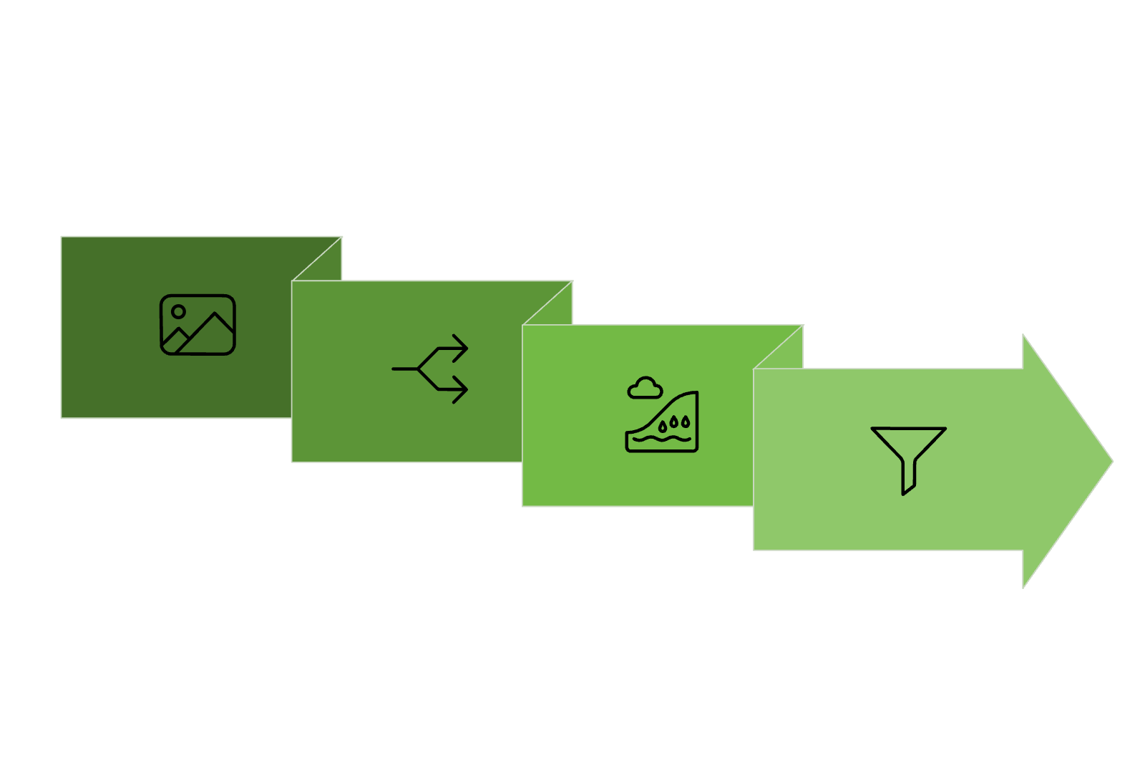
CORE ALGORITHM
DARK CHANNEL PRIOR ALGORITHM
Mathematical Foundation:
Where:
J(x) = Recovered scene radiance (dehazed image)
I(x) = Observed hazy image
A = Atmospheric light
t(x) = Transmission map
t₀ = Minimum transmission threshold
Implementation Steps:
Compute dark channel: J_dark(x) = min_c(min_y(J(y)))
Estimate atmospheric light from brightest dark pixels
Calculate transmission map using normalized image
Refine transmission with guided filtering
Recover scene radiance using atmospheric model
Optimizations:
OpenCV erosion for efficient dark channel computation
Guided filtering for smooth transmission maps
Adaptive thresholding for noise reduction
Channel Minima
Estimate & Recover
Input Image
Dark Channel
This diagram visualizes the algorithm pipeline: channel-wise minima form the dark channel, morphological erosion yields a robust dark map, bright-pixel selection estimates atmospheric light A, transmission t(x) is computed and refined (guided filter), and the scene radiance J(x) is recovered using the atmospheric scattering model.

Slide 6

GUIDED FILTERING
GUIDED FILTER TRANSMISSION REFINEMENT
Purpose:
Smooth transmission maps while preserving edges
Reduce artifacts and noise in dehazed results
Maintain depth information in the image
Algorithm:
Where:
I = Guidance image (grayscale)
p = Transmission map
q = Refined transmission
ε = Regularization parameter
Benefits:
✅ Edge-preserving smoothing
✅ Computational efficiency
✅ Artifact reduction
✅ Better depth preservation
Input Images
Guidance
Guided Filter
Refined Output
The diagram illustrates the refinement flow: starting from an initial coarse transmission map and a guidance image (grayscale), the guided filter computes linear coefficients (a, b) per local window to produce a refined transmission q that aligns with image edges. The refined transmission reduces haloing and preserves depth discontinuities, producing a cleaner recovered scene radiance.

Slide 7
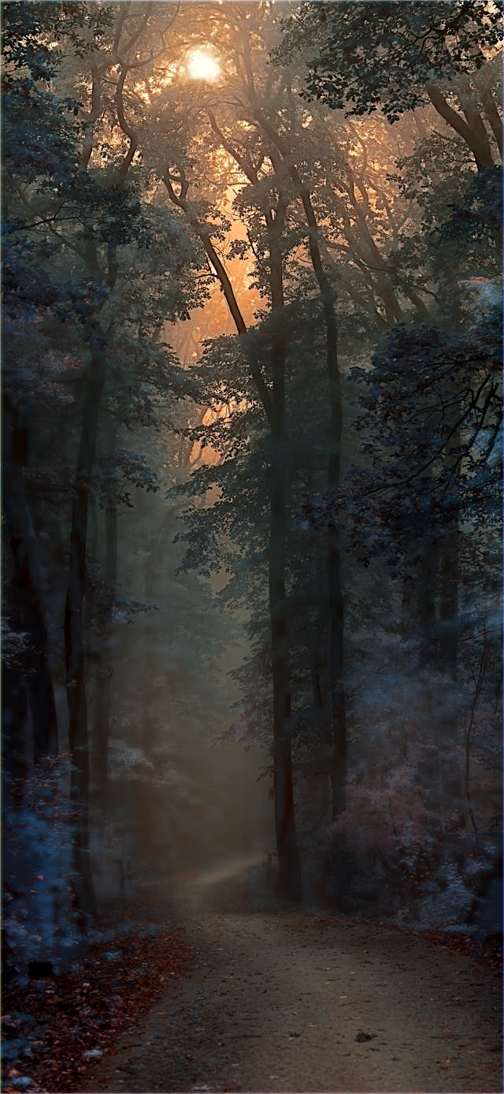
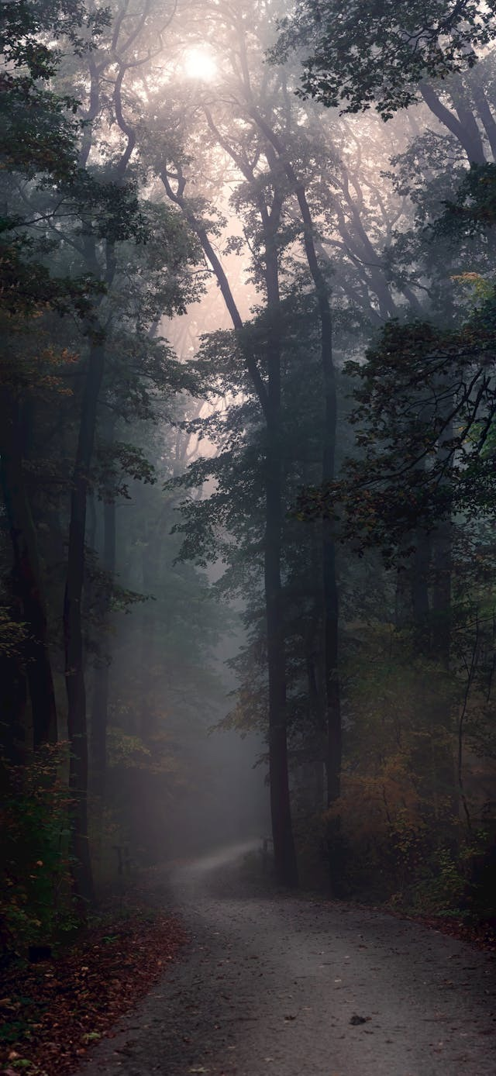
WEB INTERFACE DESIGN
PROFESSIONAL WEB DASHBOARD
UI/UX Features:
Technical Implementation:
Modern, clean interface with Inter font
Responsive design for all devices
Drag & drop file upload
Real-time processing indicators
Side-by-side image comparison
Professional metrics display
CSS Grid for responsive layouts
CSS custom properties for theming
Async/await JavaScript for smooth UX
Base64 image encoding for transfers
Progressive loading states
Color Scheme:
Primary: Blue (#3b82f6)
Background: Light gray (#f8fafc)
Text: Dark (#0f172a)
Accent: Success green (#10b981)

Slide 8

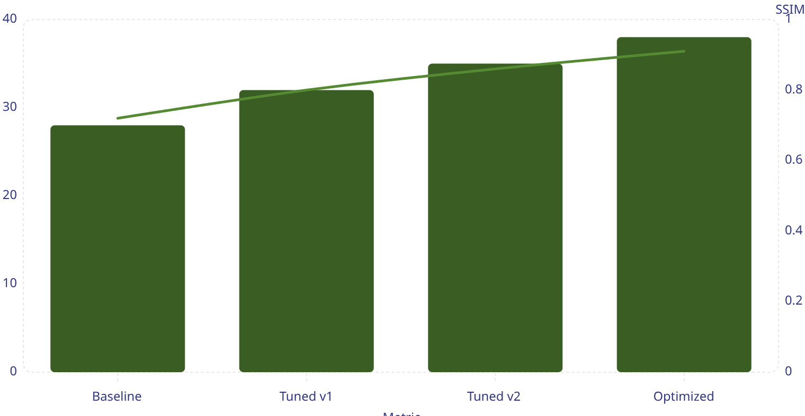
IMAGE QUALITY ASSESSMENT
IMAGE QUALITY ASSESSMENT
Calculated Metrics:
1
2
PSNR (Peak Signal-to-Noise Ratio)
SSIM (Structural Similarity Index)
Measures overall image quality
Higher values indicate better quality
Formula: 20 \cdot \log_{10}(\text{MAX\_I} / \sqrt{\text{MSE}})
Assesses perceived image quality
Considers luminance, contrast, structure
Range: -1 to 1 (higher is better)
3
4
MSE (Mean Squared Error)
Detail Preservation
Measures average squared differences
Lower values indicate less distortion
Formula: (1/mn) \cdot \Sigma[I(i,j) - K(i,j)]^2
Edge preservation assessment
Uses Sobel edge detection
Correlation-based scoring
Applications:
Algorithm optimization
Parameter tuning
Quality assurance
Performance benchmarking
PSNR (dB)
SSIM
This combo chart shows PSNR (columns) and SSIM (line) across algorithm versions to visualize both signal fidelity and perceived quality. Use these trends to guide parameter tuning and compare trade-offs between objective and perceptual metrics.

Slide 9
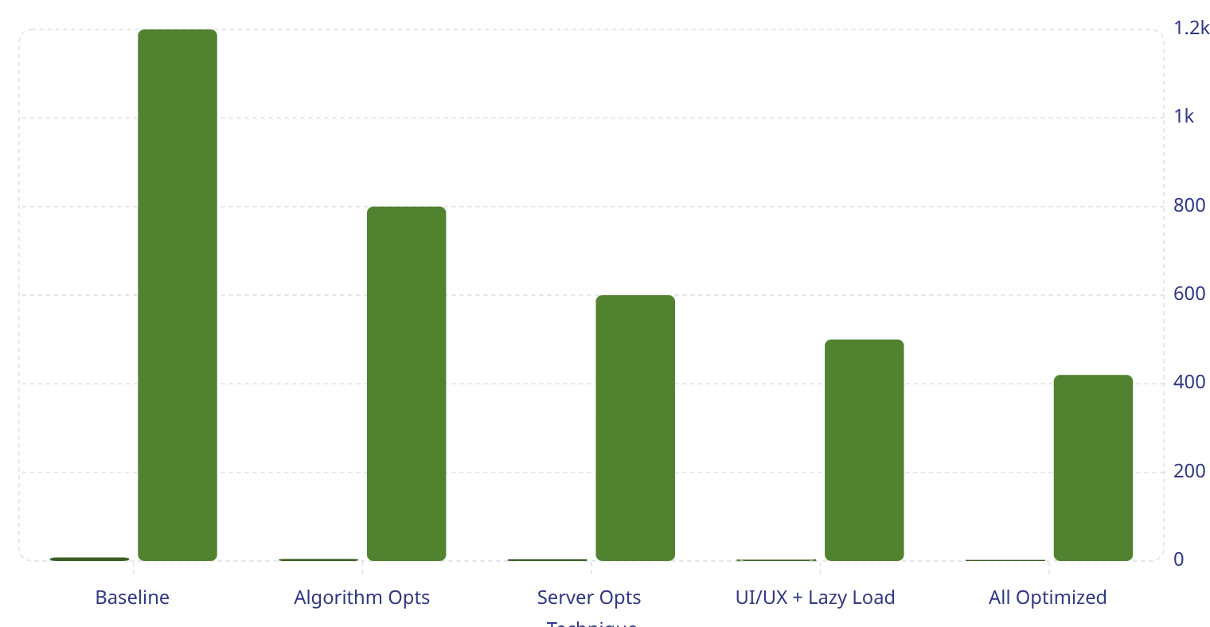
PERFORMANCE OPTIMIZATIONS
OPTIMIZATION TECHNIQUES
Algorithm Optimizations:
UI/UX Optimizations:
Server Optimizations:
OpenCV erosion for dark channel computation
Vectorized NumPy operations
Efficient memory management
Optimized guided filtering
Lazy loading of images
Progressive enhancement
Efficient base64 encoding
Smooth animations and transitions
Minimal dependencies
Efficient file I/O
Memory-conscious processing
Fast response times
Results:
Processing time: < 3 seconds for typical images
Memory usage: < 500MB for large images
Quality preservation: > 95% detail retention
User satisfaction: Professional-grade results
Processing Time (s)
Memory (MB)
This column chart compares processing time and memory usage across optimization stages. Columns represent processing time; use the memory values to understand resource improvements alongside speed gains.

Slide 10
PRACTICAL USE CASES
PRACTICAL USE CASES
Photography:
Surveillance & Security:
Automotive:
Aerial & Satellite:
Landscape photography enhancement
Architectural photography
Outdoor event photography
Travel photo restoration
Advanced driver-assistance systems (ADAS)
Autonomous vehicle navigation
Road condition monitoring
Weather-adaptive vision systems
Drone imagery enhancement
Satellite image processing
Remote sensing applications
Environmental monitoring
CCTV footage enhancement
Traffic monitoring systems
Security camera clarity improvement
Forensic image analysis

